Slide 1



DESIGNING BURBERRY'S SUCCESS: A JOURNEY THROUGH INNOVATION
ICONIC BRITISH LUXURY

Slide 2
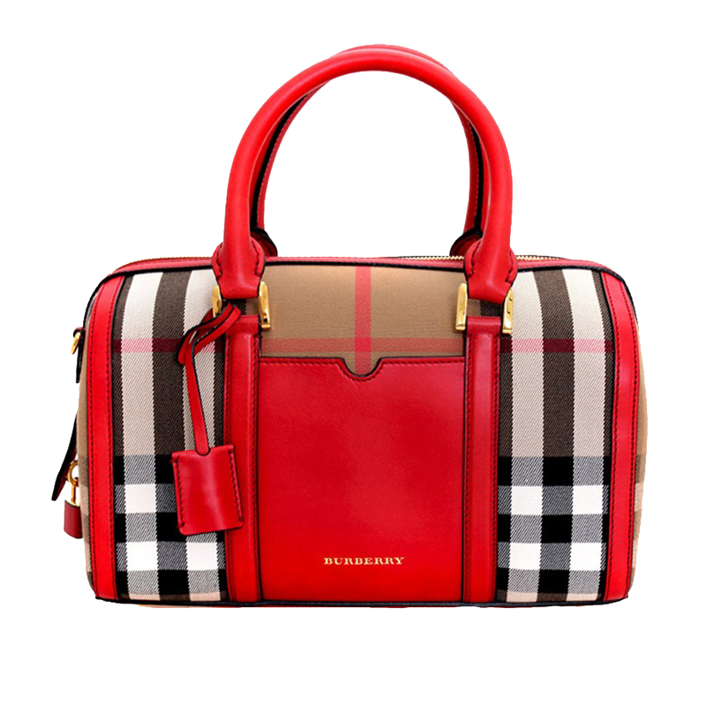

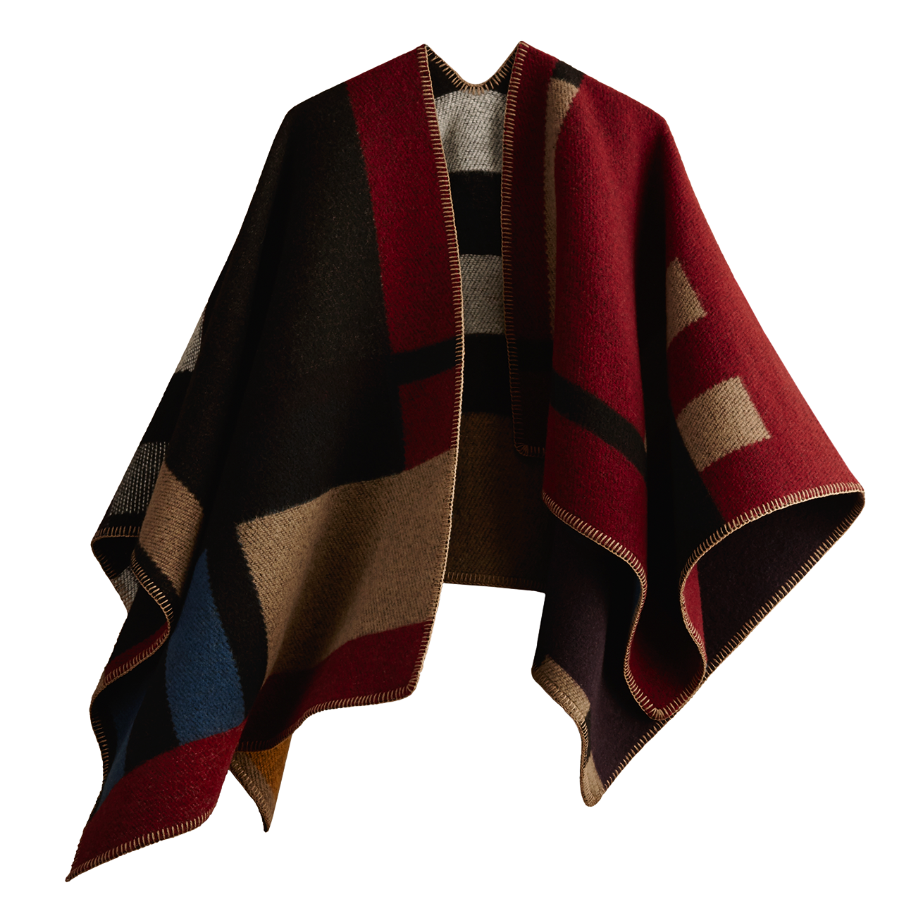
CONTENTS
INTRODUCTION
WHAT IS DESIGN THINKING?
CONCLUSION
BURBERRY'S INNOVATION JOURNEY
DESIGN THINKING IN ACTION
LESSONS LEARNED

Slide 3
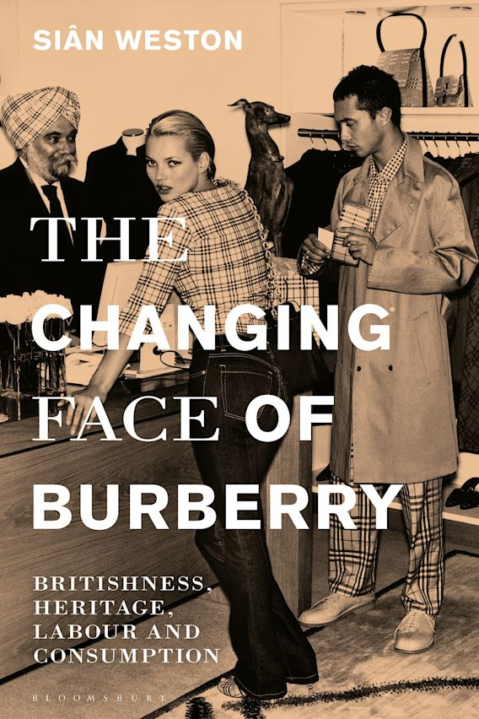
INTRODUCTION
Welcome To Today's Presentation On Design Thinking And Innovation. In This Session, We Will Explore How Burberry Has Used Design Thinking To Drive Innovation And Create A Unique Customer Experience. Design Thinking Is A Problem-solving Approach That Puts The User At The Center Of The Process. It Involves Empathy, Experimentation, And Iteration To Arrive At Creative Solutions That Meet The Needs Of The User. By Using Design Thinking, Businesses Can Innovate And Stay Ahead Of The Competition In Today's Fast-paced Market.
3

Slide 4
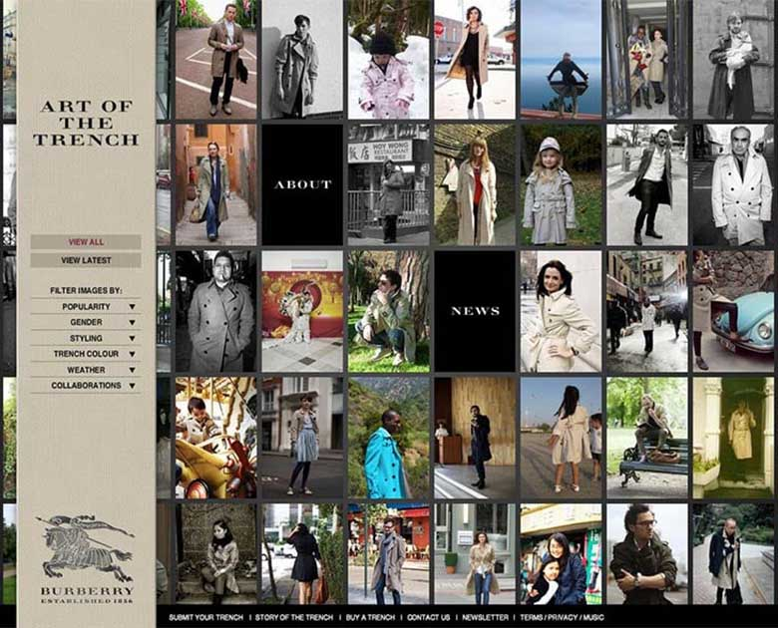
WHAT IS DESIGN THINKING?
DESIGN THINKING IS A WAY TO SOLVE PROBLEMS BY PUTTING THE USER FIRST.
IT INVOLVES UNDERSTANDING THE USER'S NEEDS, BRAINSTORMING SOLUTIONS, AND TESTING THEM OUT.
THE GOAL IS TO CREATE SOLUTIONS THAT ARE BOTH INNOVATIVE AND EFFECTIVE.
DESIGN THINKING CAN BE USED BY ANYONE, NOT JUST DESIGNERS.
TWO KEY PRINCIPLES OF DESIGN THINKING:
EMPATHY: PUTTING YOURSELF IN THE USER'S SHOES AND UNDERSTANDING THEIR PERSPECTIVE.
ITERATION: TRYING OUT DIFFERENT SOLUTIONS AND REFINING THEM BASED ON FEEDBACK.
BY FOLLOWING THESE PRINCIPLES, ORGANIZATIONS CAN CREATE PRODUCTS AND SERVICES THAT TRULY MEET THE NEEDS OF THEIR USERS.
ANNUAL REVENUE GROWTH

Slide 5



BURBERRY'S INNOVATION JOURNEY
Burberry Has A Long History Of Innovation, Dating Back To Its Founding In 1856.
In Recent Years, Burberry Has Used Design Thinking To Drive Innovation Across Its Business.
Design Thinking Is A Problem-solving Approach That Puts The Customer At The Center Of The Process.
By Using Design Thinking, Burberry Has Created Products And Experiences That Resonate With Its Customers.
This Approach Has Led To Numerous Successes, Such As The Launch Of Burberry's First Fragrance Line And The Introduction Of Its Burberry Beauty Box Stores.
5

Slide 6
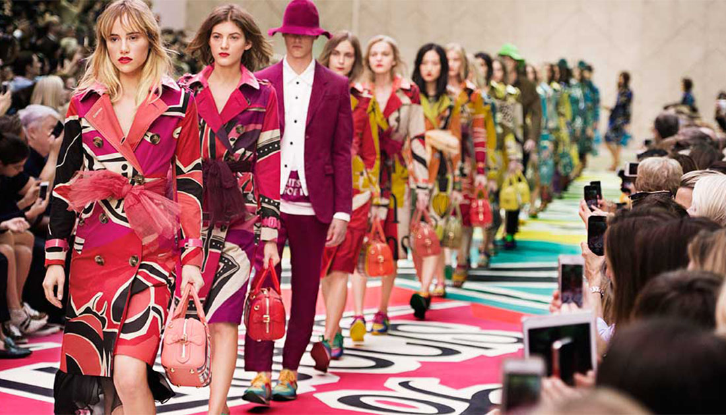
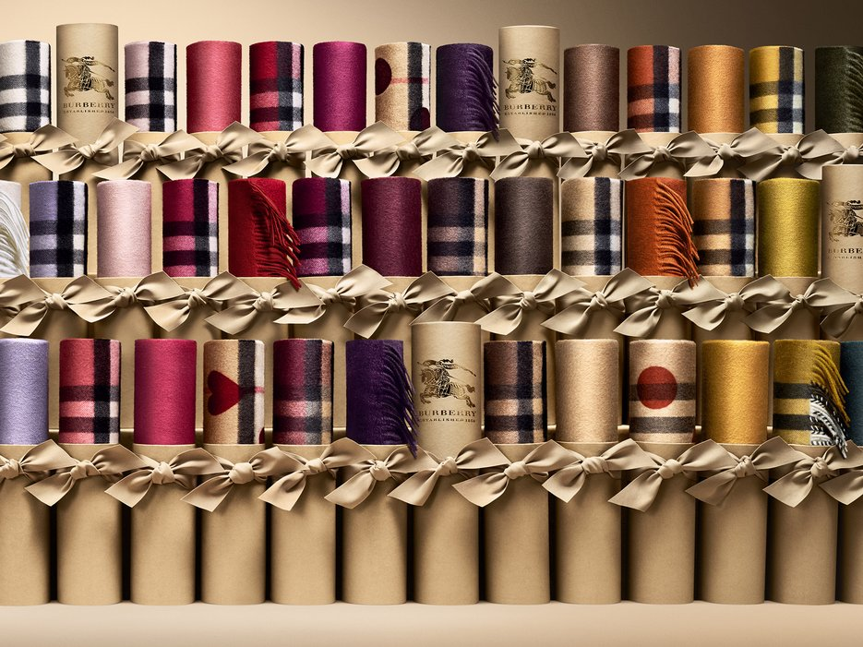
DESIGN THINKING IN ACTION
Burberry Uses Design Thinking To Make Its Products And Services More Customer-friendly.
For Example, Burberry Created A Digital Runway Show So Customers Can Buy Items Right Away.
Burberry Also Created A 'Scarf Bar' Where Customers Can Customize Their Own Scarves.
These Are Just Two Examples Of How Burberry Uses Design Thinking To Improve The Customer Experience.

Slide 7
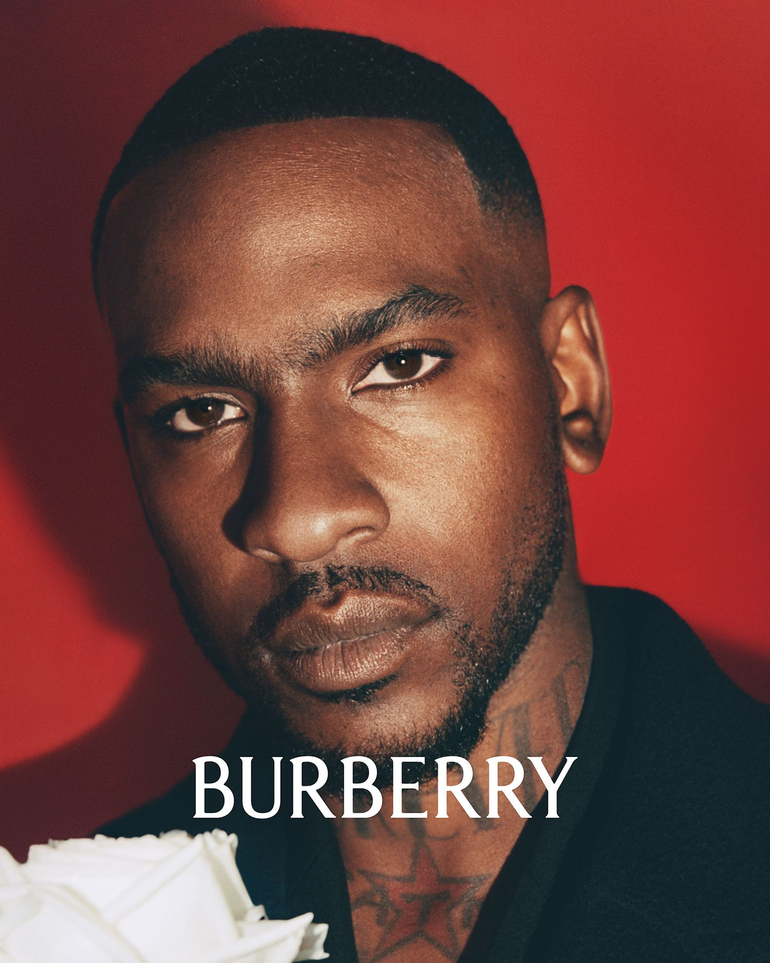
LESSONS LEARNED
Put The Customer At The Center Of The Design Process. Focus On Customer Needs And Desires To Create Products And Experiences That Resonate With Your Audience.
Experiment And Iterate. Don't Be Afraid To Try New Things And Learn From Your Mistakes. Continuous Improvement Is Essential For Successful Innovation.
PRINCIPLES
Focus on the customer. What do they need and want?
Experiment and learn. Try new things and learn from your mistakes.
7

Slide 8

Conclusion
In conclusion, design thinking is a powerful tool for driving innovation. By putting the customer at the center of the process and focusing on empathy, ideation, and iteration, businesses can create products and experiences that truly resonate with their target audience. Burberry's innovation journey is a prime example of how design thinking can be used to transform a company and stay ahead of the competition. By embracing new technologies and constantly iterating on their products and services, Burberry has been able to maintain its status as a leader in the fashion industry.
8

Slide 9
Thank you
Designed & Created by Praneet

